Slide 1
Margaret Brown
(Royal Society Education Committee)
Ian Jones
(Vision Project Committee)

Slide 2
Goals of the Vision Report
To raise the general level of mathematical and scientific knowledge and confidence in the population.
To ensure that education systems deliver learning and skills that are linked to the current and future needs of the economy.

Slide 4
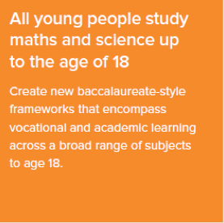

Slide 5
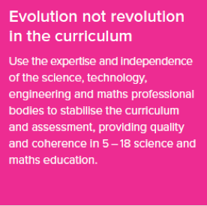

Slide 6
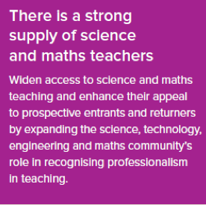

Slide 7
Action so far and future plans
Students understand the significance of STEM through better careers awareness and guidance:
Briefing provided for a Westminster Hall debate and plan to engage with the new government on careers advice.
Continue to develop and improve RS outreach schemes.

Slide 8
Action so far and future plans
Performance measures value good teaching:
Responded to several Ofqual consultations on how to assess practical science, and met with Ofqual to discuss the new arrangements.

Slide 9
Action so far and future plans
Education policy and practice are informed by evidence:
Scoping a project on education research, to map the STEM education research workforce and funding landscape, and examine priority-setting by education research funders.

Slide 10
Action so far and future plans
All young people study mathematics and science to 18:
Core Maths is currently under large-scale trials with 150+ institutions co-ordinated via Maths Hubs.
All students with GCSE D need to re-sit; below D resit or stepping stone.

Slide 11
Action so far and future plans
Evolution not revolution in the curriculum:
Discussions were held in 2014 with ministers and party spokespeople especially with regard to baccalauriate
After CMS discussion agreement to take forward subject committee proposal with JMC
RS has commissioned a set of international comparison case studies of how curriculum change is done in other countries.

Slide 12
Action so far and future plans
Teachers have high professional status and there is a strong supply of science and maths teachers:
The Government announced in March a variety of measures to increase teacher recruitment and support in maths and physics
The RS has endorsed a new College of Teaching, and will offer further support
Several teacher events on the Vision report, and an industry roundtable to support teachers and CPD, have been held.

